Slide 1
ISTIO – Policy and Security
Evgeniy stoyanov

Slide 2
Architecture

Slide 3
Components
Citadel – certificate management
Sidecart – implements secure communication
Pilot – distribute authentication policies and secure naming information to the proxies
Mixer – manages authorization and auditing

Slide 4
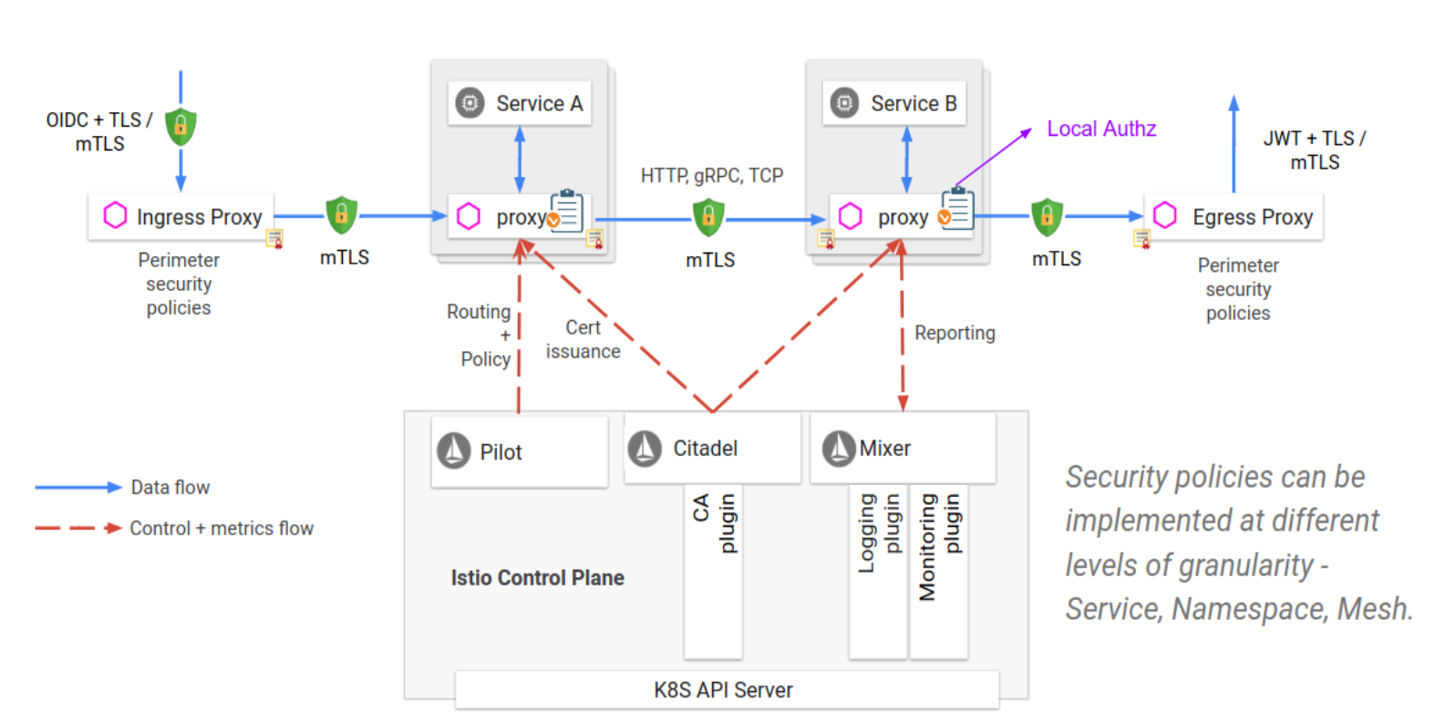

Slide 5
Identity

Slide 6
Istio identity
Secure naming - verifies that the authenticated server’s service account can run the named service.
Authorization policies - the server can determine what information the client can access

Slide 7
Authentication

Slide 8
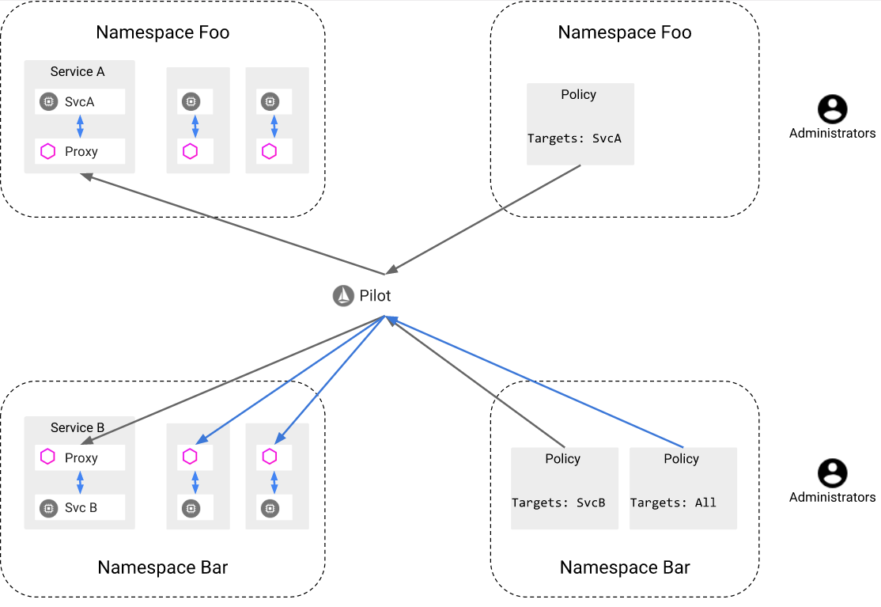

Slide 9
Authentication options
Transport authentication – service to service
Uses mutual TLS (two ways authentication)
Can be applied without any code changes
Client - destination rules configuration
Server – authentication policy
Origin authentication – user to service
Only JWT token
Providers: Auth0, Google Auth … , Custom provider
Application is responsible for acquiring and attaching the JWT credential to the request

Slide 10
Authentication policies
Applies to request that service receives
Authentication rules configured on the client side
Destination rules
Scopes
Service scope
Mesh scope
Namespace scope

Slide 11
Example Namespace and Mesh scopes
apiVersion: “…"
kind: "Policy"
metadata:
name: "default"
namespace: "ns1"
spec:
peers:
- mtls: {}
apiVersion: “….”
kind: "MeshPolicy"
metadata:
name: "default"
spec:
peers:
- mtls: {}

Slide 12
Example Service scope
apiVersion: "authentication.istio.io/v1alpha1"
kind: "Policy"
metadata:
name: "reviews"
spec:
targets:
- name: reviews
peers:
- mtls: {}

Slide 13
Example Destination rule
apiVersion: networking.istio.io/v1alpha3
kind: DestinationRule
metadata:
name: db-mtls
spec:
host: mydbserver.prod.svc.cluster.local
trafficPolicy:
tls:
mode: MUTUAL
clientCertificate: /etc/certs/myclientcert.pem
privateKey: /etc/certs/client_private_key.pem
caCertificates: /etc/certs/rootcacerts.pem

Slide 14
Origin authentication
Istio only supports JWT origin authentication
Providers:
Auth0
Google Auth
Custom Provider
…

Slide 15
Example
origins:
- jwt:
issuer: "https://accounts.google.com"
jwksUri: "https://www.googleapis.com/oauth2/v3/certs"
trigger_rules:
- excluded_paths:
- exact: /health

Slide 16
Authorization

Slide 17
Options for configuration
Http configuration
Tcp configuration

Slide 18
Role based access control
Access levels:
Namespace level
Service level
Method level

Slide 19
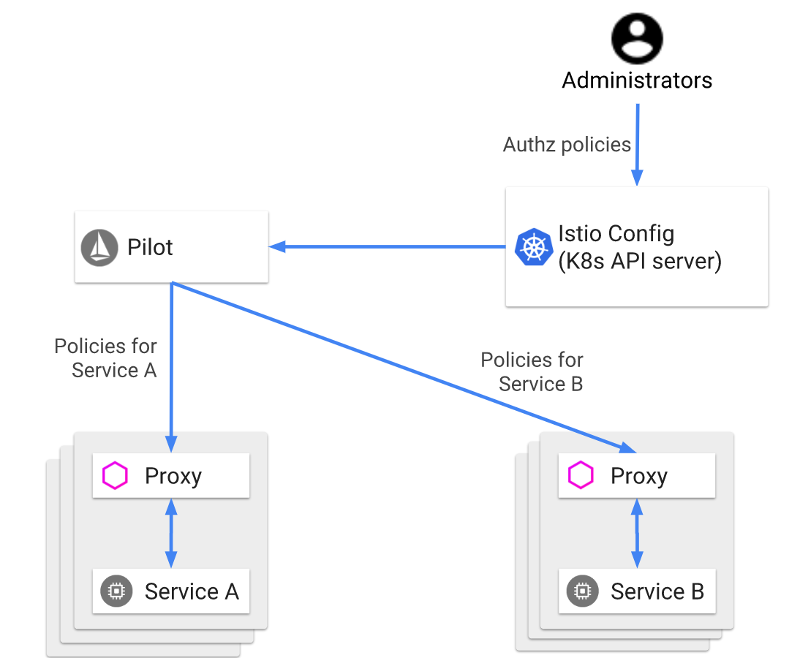

Slide 20
Authorization configuration
ClusterRbacConfig object
Options
OFF: disabled
ON: enabled for all service
ON_WITH_INCLUSION
ON_WITH_EXCLUSION

Slide 21
Example
apiVersion: "rbac.istio.io/v1alpha1"
kind: ClusterRbacConfig
metadata:
name: default
spec:
mode: 'ON_WITH_INCLUSION'
inclusion:
namespaces: ["default"]

Slide 22
Authorization policy
ServiceRole – includes list of rules (server side)
ServiceRoleBinding (client side)
RoleRef is binding to the ServiceRole
Subjects is a list of the “constraints” when to apply this ServiceRole

Slide 23
ServiceRole object
Services – list of services
Methods – list of http methods
Paths – list of http paths
Constraints – list of the conditions to apply

Slide 24
Example 1
apiVersion: "rbac.istio.io/v1alpha1"
kind: ServiceRole
metadata:
name: products-viewer
namespace: default
spec:
rules:
- services: ["products.default.svc.cluster.local"] // * for all
methods: ["GET", "HEAD"]

Slide 25
Example 2
apiVersion: "rbac.istio.io/v1alpha1"
kind: ServiceRole
metadata:
name: tester
namespace: default
spec:
rules:
- services: ["test-*"]
methods: ["*"]
- services: ["bookstore.default.svc.cluster.local"]
paths: ["*/reviews"]
methods: ["GET"]

Slide 26
ServiceRole Binding http example
apiVersion: "rbac.istio.io/v1alpha1"
kind: ServiceRoleBinding
metadata:
name: binding-products-allusers
namespace: default
spec:
subjects:
- user: "*"
roleRef:
kind: ServiceRole
name: "products-viewer"
apiVersion: "rbac.istio.io/v1alpha1"
kind: ServiceRoleBinding
metadata:
name: binding-products-all-authenticated-users
namespace: default
spec:
subjects:
- properties:
source.principal: "*"
roleRef:
kind: ServiceRole
name: "products-viewer"

Slide 27
ServiceRole Binding http example
apiVersion: "rbac.istio.io/v1alpha1"
kind: ServiceRole
metadata:
name: mongodb-viewer
namespace: default
spec:
rules:
- services: ["mongodb.default.svc.cluster.local"]
constraints:
- key: "destination.port"
values: ["27017"]
apiVersion: "rbac.istio.io/v1alpha1"
kind: ServiceRoleBinding
metadata:
name: bind-mongodb-viewer
namespace: default
spec:
subjects:
- user: "bookinfo-ratings-v2“
- properties:
- request.headers[“x-name”] = ev
roleRef:
kind: ServiceRole
name: "mongodb-viewer"

Slide 28

Questions?

Slide 29
Homework
Task: istio security
Instructions: in attachments

